Slide 1

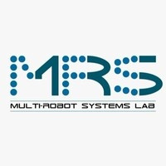
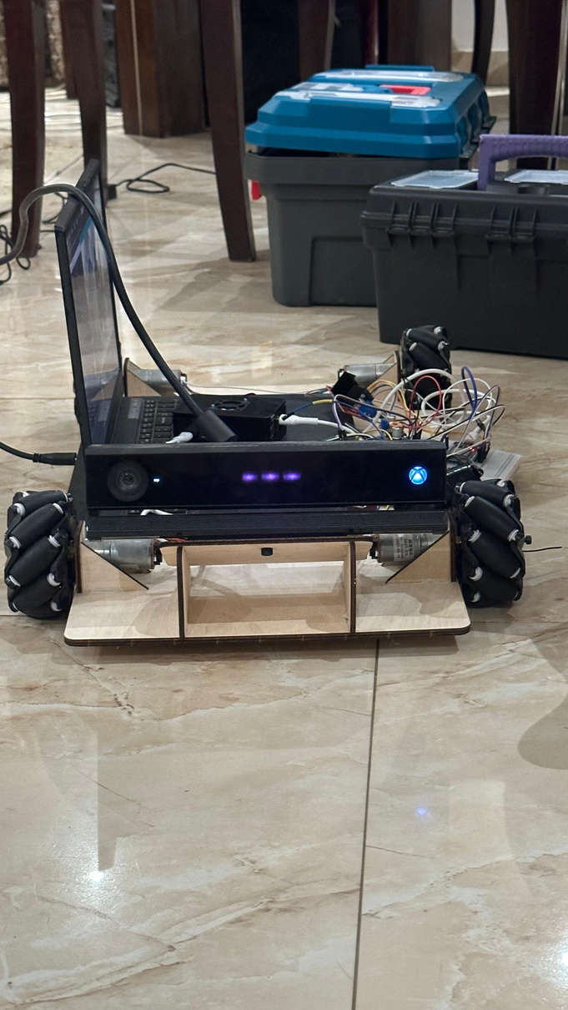
WoodBull
Hadil Amin Mostafa Maged Youssef Ali Ahmed Ashraf
Assoc. Prof. Dr. Eng. Omar M. Shehata, Eng. Dalia M. Mahfouz, PhD, Eng. Abdelrahman Hatem, MSc. and Eng. Mohammed Ashraf
Image Processing for Mechatronics (MCTR1010)
Spring 2026
Abstract
Methodology
Customer Segments
Conclusion
This project presents WoodBull, a mobile robot designed to follow a red scarf using vision-based techniques. The system relies on an Xbox Kinect camera to capture both color and depth information from the environment.
Image processing methods were applied to detect the red color of the scarf and track its position in real time, while depth data was used to estimate distance and guide the robot’s movement safely and accurately.
By combining color detection with depth sensing, the robot is able to follow a moving target in a dynamic environment.
The project demonstrates how relatively simple image processing techniques can be integrated with hardware to create an interactive and responsive robotic system.
WoodBull demonstrates how image processing and depth sensing can be effectively combined to achieve real-time target tracking. By using a Kinect camera for color and depth information, the robot was able to detect and follow a red scarf with good accuracy.
The project highlights the practical use of vision-based techniques in mobile robotics and provides a foundation for more advanced autonomous tracking systems.
The system uses an Xbox Kinect camera mounted on the robot to capture synchronized RGB and depth frames in real time. Color-based detection is performed by converting each RGB frame to the HSV color space, which separates hue from lighting intensity and makes red detection more robust under varying illumination. A binary mask is applied to isolate pixels within the red hue range, and morphological operations (erosion and dilation) are used to remove noise and fill gaps in the detected region.
The centroid of the largest red contour is then computed to determine the target's 2D position in the image frame. The Kinect's depth stream maps this pixel position to a real-world distance, giving the robot both the direction and range of the target. A simple proportional controller translates this information into left/right wheel speed commands: if the centroid drifts left or right of the image center, the robot steers accordingly, and if the target distance exceeds a threshold, the robot moves forward.
Cost Structure
Results
The robot successfully detected and followed the red scarf across multiple test runs in an indoor environment. Color detection remained stable under moderate lighting variation, with the HSV-based mask reliably isolating the target even when partially occluded. The robot maintained a consistent following distance and corrected its heading smoothly when the scarf moved laterally. Depth integration prevented the robot from colliding with the target by stopping forward motion once within a safe range. Overall, the system demonstrated reliable real-time tracking with low latency between target movement and robot response.

